Slide 1
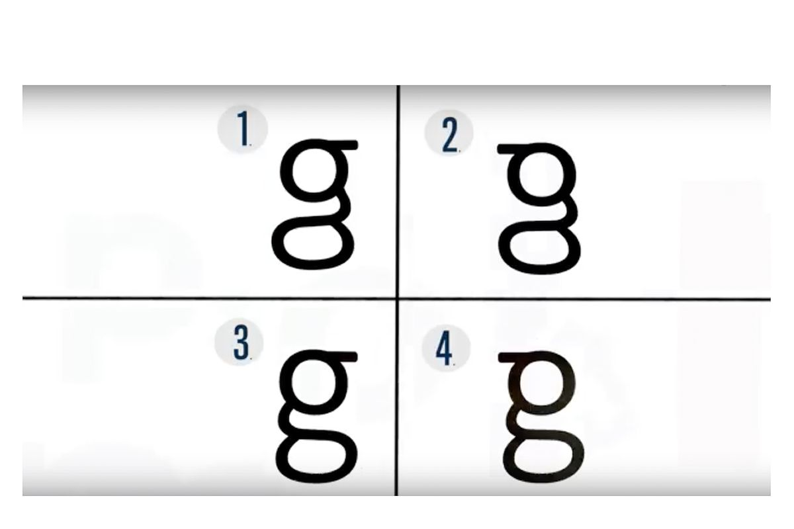
Which one is the letter G?

Slide 2
Which one is the letter G?
g from Calibri
https://www.theverge.com/2018/4/3/17192518/lowercase-g-letters-reading-writing-comprehension-penmanship

Slide 3
Video Game Proof of Concept (Exploration)
Will Wagner
IST 341 Final Project Presentation

Slide 4
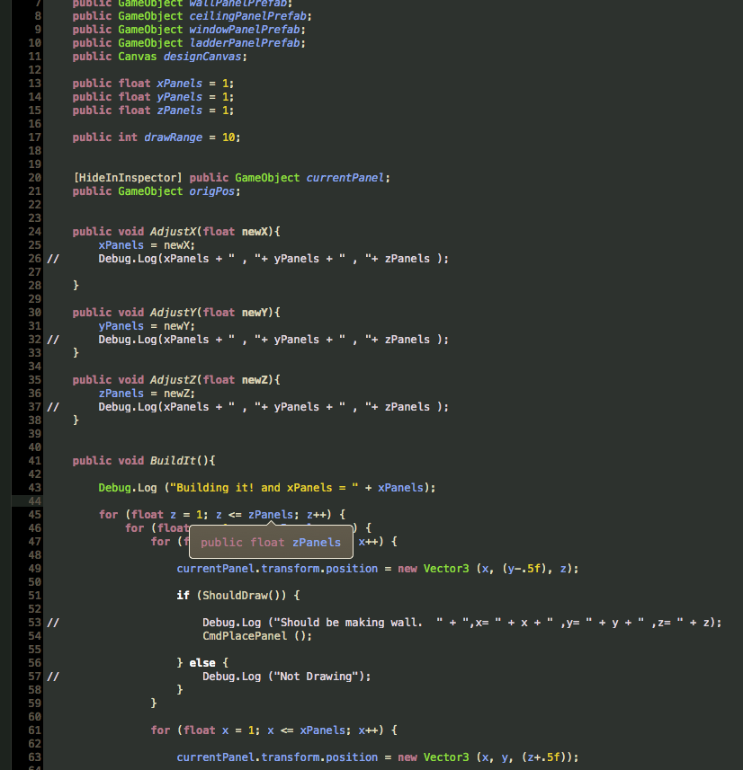
Original Concept
POC for a Destructable Environment Game
Tested some Unity Solutions - but did not find any good uses for Python with Unity
Unity is C# and Javascript
Built a cool building builder screen

Slide 5
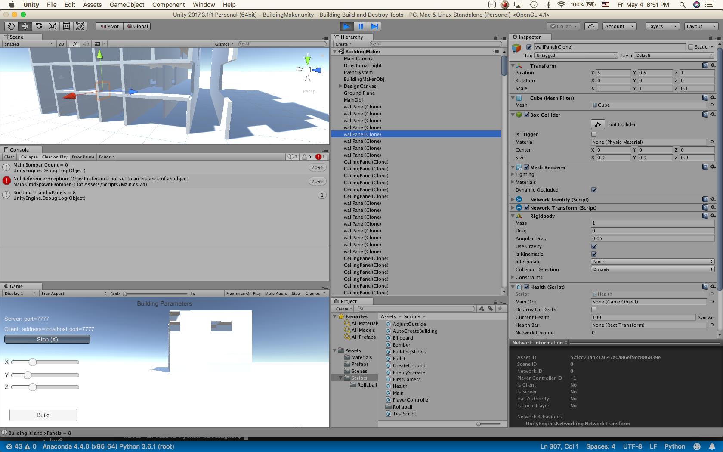

Slide 6

Python Options for Arcade Style Games
Cons
Older solution
Some of the code is out of date
Pros
Offers Python 2 support
Does not require OpenGL
Supports hardware like cameras, cdroms, MIDI
Has better support for pixel manipulation in a memory buffer that isn’t displayed on screen.

Slide 7
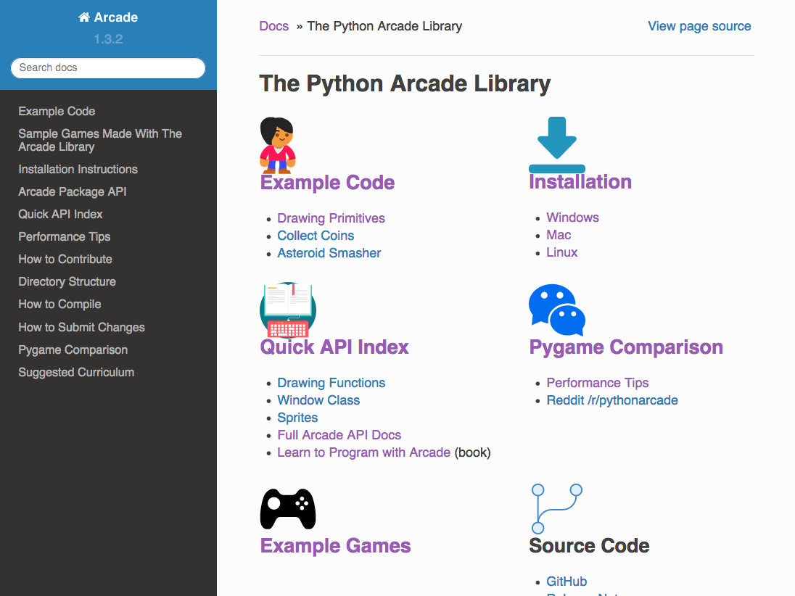

Slide 8
Supports installation via standard Python package manager, using ‘pip install’
Ellipses, arcs, and other shapes can be easily rotated.
Uses standard coordinate system you learned about in math. (0, 0) is in the lower left, and not upper left. Y-coordinates are not reversed.
Has built-in physics engine for platformers.
Supports animated sprites.
API documentation for the commands is better. Many commands include unit tests right in the documentation.
Command names are consistent. For example, to add to a sprite list you use the append() method, like any other list in Python. Pygame uses add().
Parameter and command names are clearer. For example, open_window instead of set_mode.
Basic drawing does not require knowledge on how to define functions or classes or how to do loops.
Encourages separation of logic and display code. Pygame tends to put both into the same game loop.
Runs on top of OpenGL and Pyglet, rather than the old SDL1 library.
With the use of sprite lists, uses the acceleration of the graphics card to improve performance.
Easily scale and rotate sprites and graphics.
Images with transparency are transparent by default. No extra code needed.
Lots of Example Code.

Slide 9
Jumped in to Python
Didn’t see value in adjustable buildings for now
Started with automatic building
Seemed like a good way to get feet wet
Was now thinking no longer physics based – grid based
Was more difficult than expected
Didn’t see the tutorial on array backed grids till later
Then added player
Then added spawn of sphere
As I started to think about gameplay I realized had Changed to a Vertical Tower Defense Game
Still had not decided how to do AI
Thought about a turn based or timer based solution for control
Still Thinking in terms of destructable walls and floors
Realized by spawning the hostiles when player spawns one solves both challenges
Made them spawn at the same height as player
Adjusted damage

Slide 10
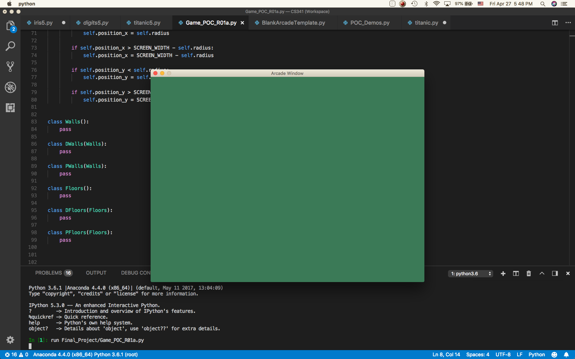

Slide 11
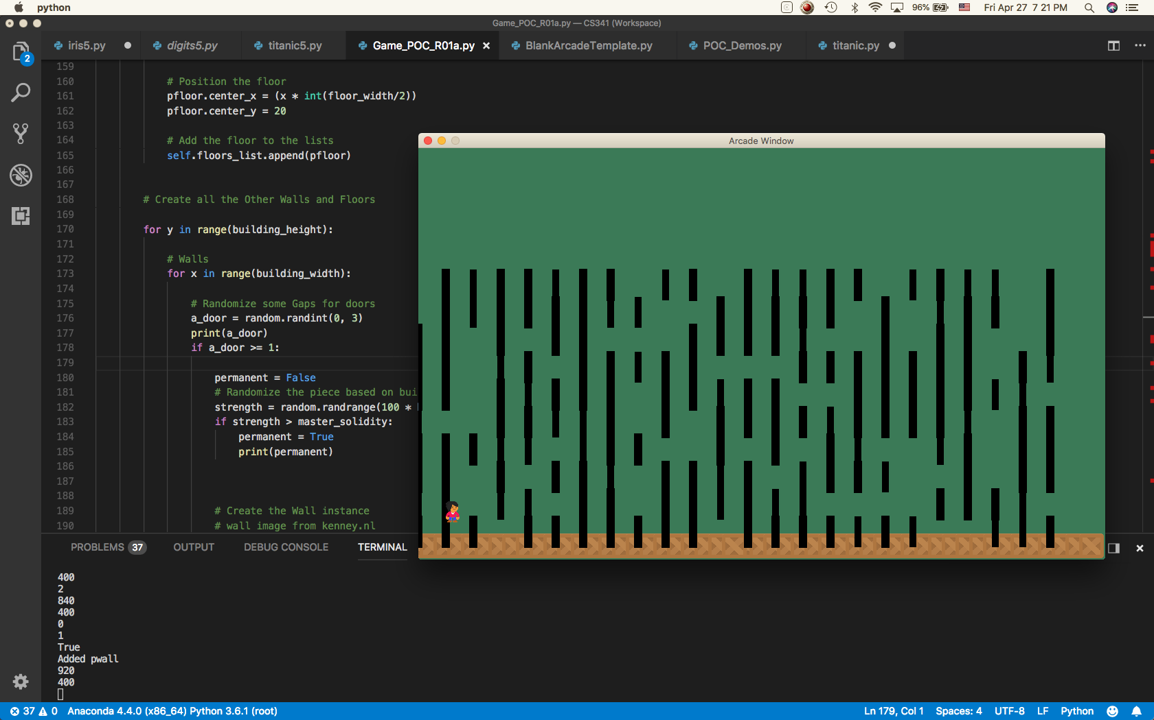

Slide 12
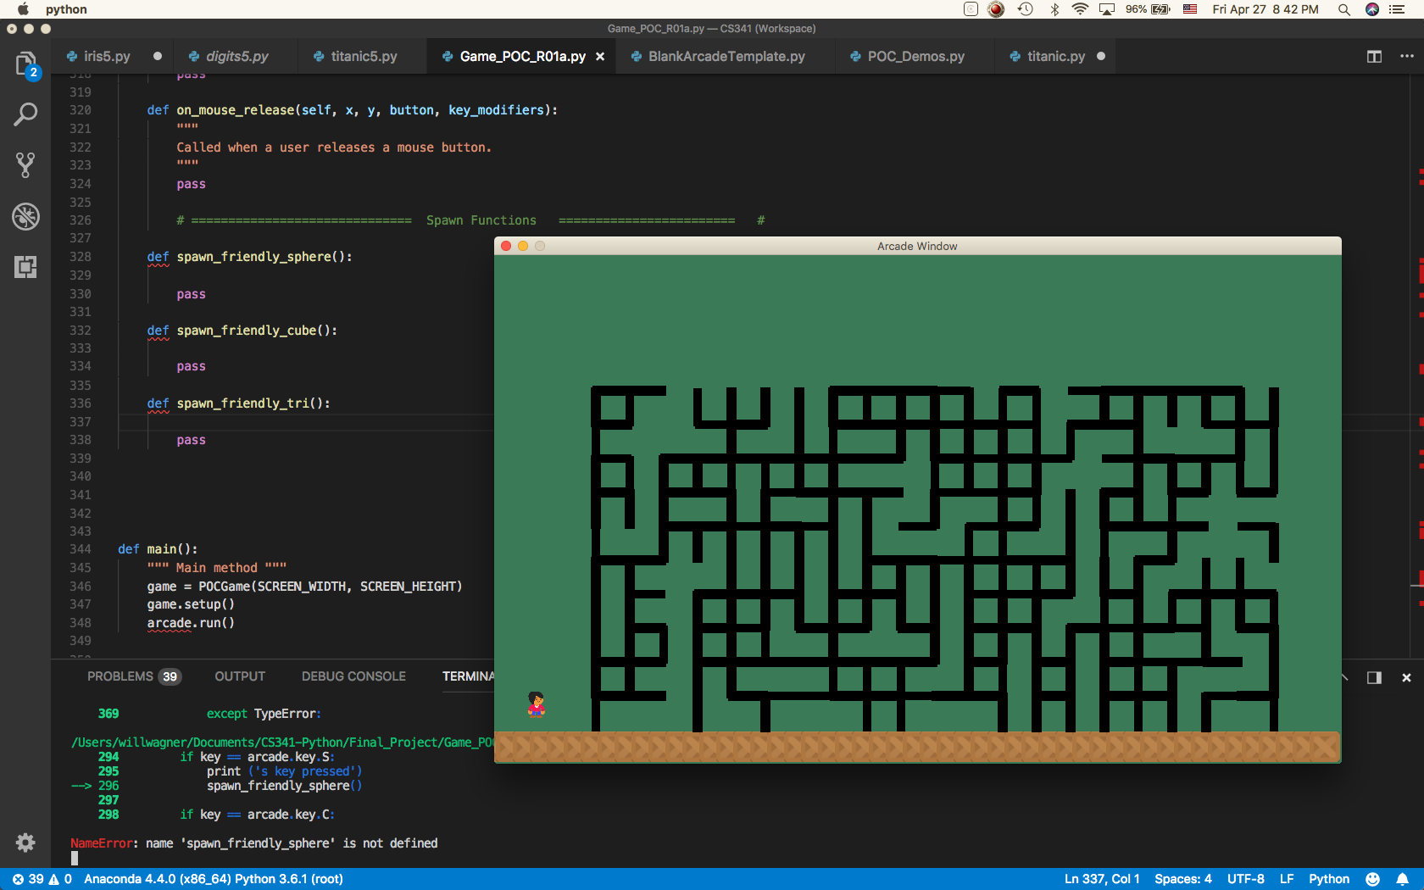

Slide 13
def spawn_friendly_sphere(self):
position_x = 125
position_y = 75 change_x = 1
change_y = 0
fsphere = MSphere(position_x,position_y,change_x,change_y)
# Set up the Sphere
fsphere.sphere_sprite = arcade.Sprite("Final_Project/sphere.png", SPRITE_SCALING_SPHERE)
fsphere.sphere_sprite.center_x = position_x
fsphere.sphere_sprite.center_y = position_y
self.spheres_list.append(fsphere.sphere_sprite)
self.friendlies_list.append(fsphere)
def spawn_friendly_cube(self): pass
def spawn_friendly_tri(self): pass
# Sphere
class MSphere():
def __init__(self, center_x, center_y, change_x, change_y):
# Call the parent class's init function
# super().__init__(position_x, position_y, change_x, change_y)
# Take the parameters of the init function above, and create instance variables out of them.
self.position_x = center_x
self.position_y = center_y
self.change_x = change_x
self.change_y = change_y
def update(self):
# Move the Shape
self.center_y += self.change_y
self.center_x += self.change_x

Slide 14
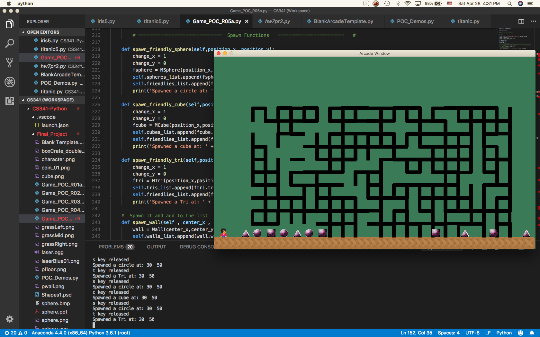

Slide 15
Game morphed again
Decided I didn’t want to have pieces jump on grid system
Back to including some physics to smooth movement
As I started to play it became fun!
Solution to turn based and timer questions was to spawn an enemy whenever player spawns one
Started to be a small challenge to get to the objective
Floors not destructible right now
Physics added much
Was experimenting with different programming structures

Slide 16
Looking at things from different perspective:
https://sploid.gizmodo.com/how-can-this-spinning-arrow-that-always-points-right-ac-1825710253

Slide 17
V1
V7
def spawn_friendly_sphere(self):
position_x = 125
position_y = 75 change_x = 1
change_y = 0
fsphere = MSphere(position_x,position_y,change_x,change_y)
# Set up the Sphere
fsphere.sphere_sprite = arcade.Sprite("Final_Project/sphere.png", SPRITE_SCALING_SPHERE)
fsphere.sphere_sprite.center_x = position_x
fsphere.sphere_sprite.center_y = position_y
self.spheres_list.append(fsphere.sphere_sprite)
self.friendlies_list.append(fsphere)
def spawn_sphere(self,position_x, position_y, friendly):
if friendly:
fsphere = MSphere(position_x,position_y,1,0,1)
self.spheres_list.append(fsphere.sphere_sprite)
self.friendlies_list.append(fsphere.sphere_sprite)
print('Spawned a circle at: ' + str(position_x) + ' ' + str(position_y))
else:
fsphere = MSphere(position_x,position_y,-1,0,0)
self.hostile_spheres_list.append(fsphere.sphere_sprite)
self.hostiles_list.append(fsphere.sphere_sprite)
print('Spawned a circle at: ' + str(position_x) + ' ' + str(position_y))

Slide 18
Time out from presentation to play a game…

Slide 19
The Future…
Friendly and Hostile Artificial Intelligence
Sandbox for learning AI
Sandbox for Physics Engines
.arcade – built in engines
.pymunk – supported 3rd party engine in .arcade
Slightly more complicated
Significantly more features
Have to learn another API worth of commands but likely worth it
Ex: Momentum
Multi-Player
Sandbox for Networking
Variable sized and shaped Buildings
Physics based walls and floors
Destructable rooms
More characters and pieces
Support for different input devices
Graphics
Animations
Textures

Slide 20
What I learned
There’s an art to when to use Classes during the prototype phase
Basically if you think code will be reused 2 or 3 times
If you think the code will eventually be used in production environment then you almost certainly should
I tended to make one in-line then convert to Class
Then copy the class
This changes when the basics of the class require more than about 5-10 lines of code, in which case might as well start with a class
Also changes with better pre-production and planning
Needed to make better use of Sub-Classes
ie: Shapes
Requires better understanding of Instanced Variables
Dictionaries to make classes more flexible
ie. Characteristics for the various shapes – ex dictionary: friendly_move_speeds { player : 1 , cube : 1 , tri : 1.25 , sphere : 1.5 }
Importance of getting comfortable with Paths and Shell
OS
self.
Break the code into multiple namespaces or files?
Python is Awesome!
The libraries and web reference and syntax just feels right

